Slide 1



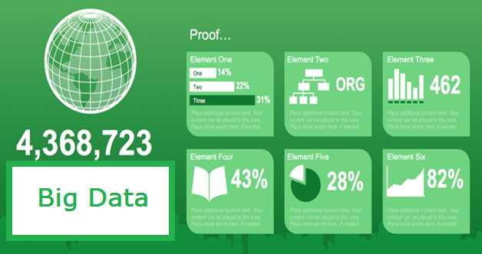
PowerPoint Infographics Sampler
Big Data,
Data Analytics and Industry Application
Session I
(8/20: 8:15-12)
Introduction
Dr. Simon Cleveland (CityU) - Overview of Big Data
Part 1
Dr. Ying Ying Zhuang (Amazon) - Data Science with R
Part 2
Yun Tse Wu (Mercedes Benz Research and Development North America) - Centralize Logging and Data pipeline

Slide 2
Introduction Overview of Big Data and Data Analytics Dr. Simon Cleveland – City University of Seattle
Big Data Industry Example
Define Big Data
Data Characteristics and Challenges of Big Data
Data Analytics Lifecycle
Big Data Technologies

Slide 3




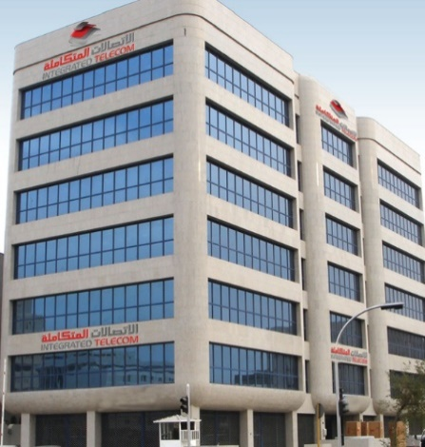
Check Out our PowerPoint Graphics Library
Telecom Example
Telecom Company
Customers
Company Management

Slide 4




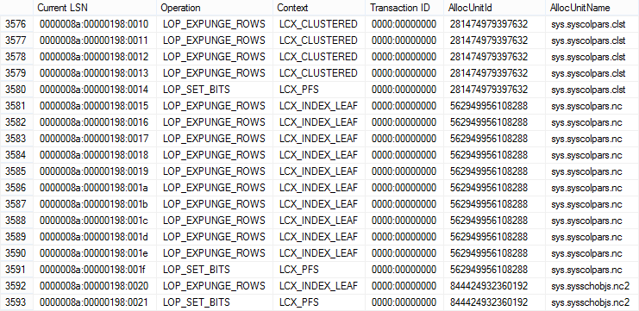
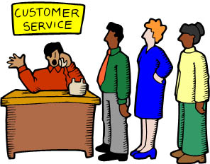

Check Out our PowerPoint Graphics Library
Multiple Data Source
Company Call Center
Company Website
Audio Data
Log Data
Company Physical Center
Text Data

Slide 5
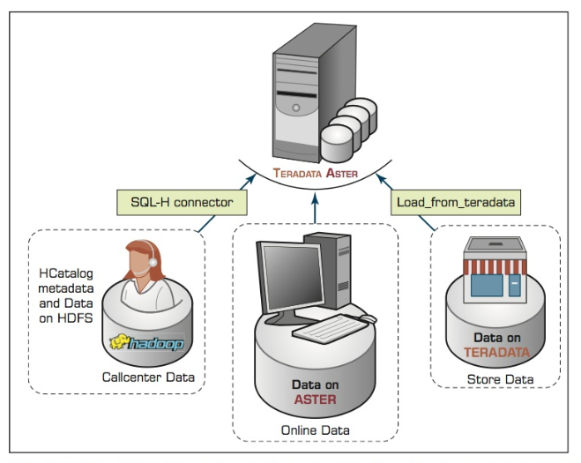
Check Out our PowerPoint Graphics Library
Data Collection and Analysis
Log Data
Audio Data
Text Data

Slide 6
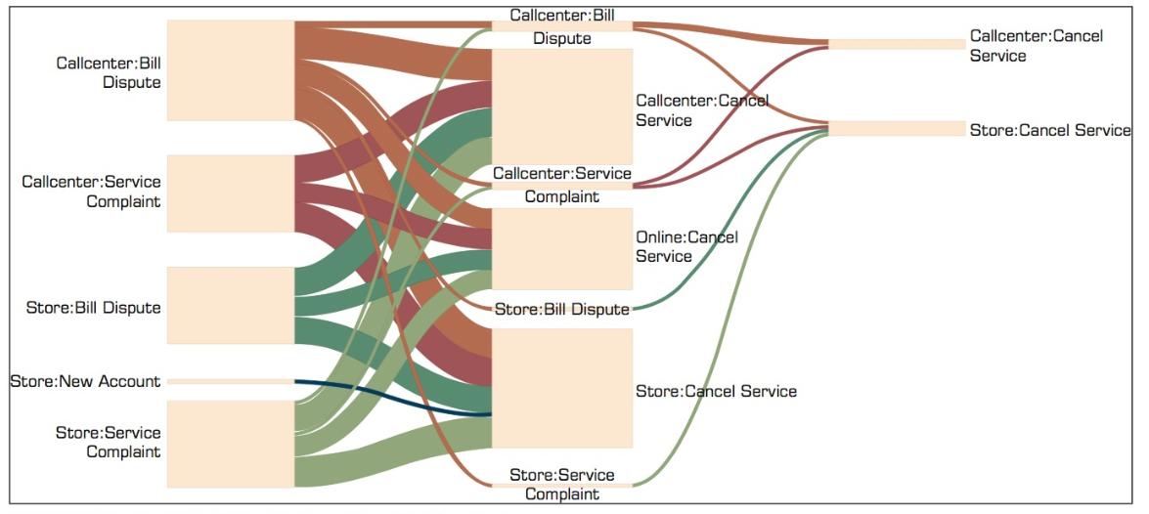
Check Out our PowerPoint Graphics Library
Top 20 Paths to Cancellation

Slide 7
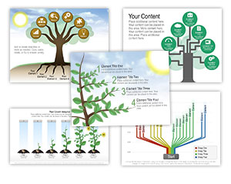
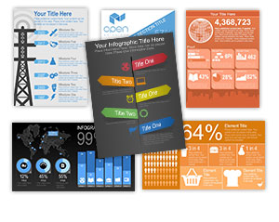
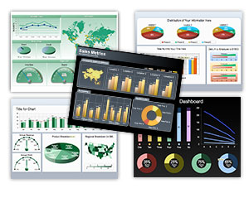
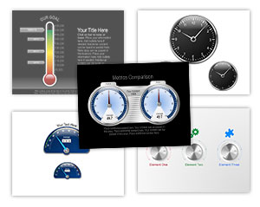
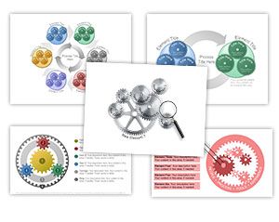
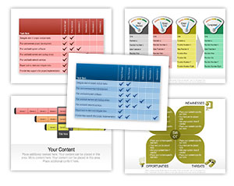
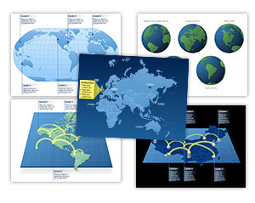
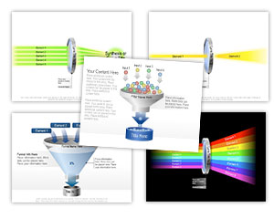
Check Out our PowerPoint Graphics Library
Definition of Big Data
“Big Data is data whose scale, distribution, diversity, and/or timeliness require the use of new technical architectures and analytics to enable insights that unlock new sources of business value.” -- McKinsey Global Report

Slide 8
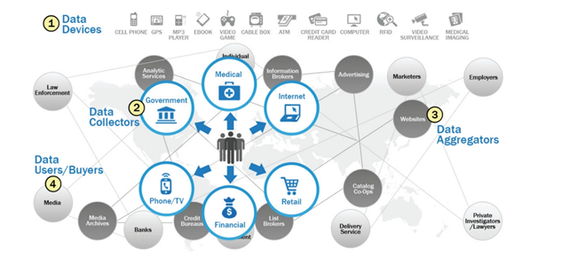
Check Out our PowerPoint Graphics Library
Big Data Ecosystem

Slide 9
Sample 2
Big Data Characteristics and Challenges
Attributes
Complexity
Veracity
Volume
Value
Speed
Place additional content here.

Slide 10
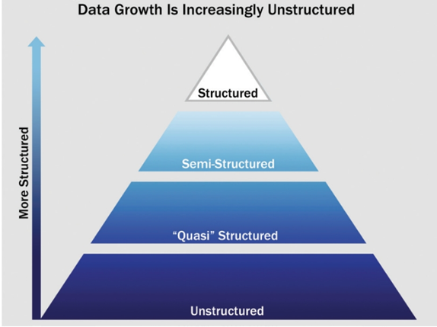
Sample 2
Big Data Challenges - Data Structures
80-90% of Data

Slide 11
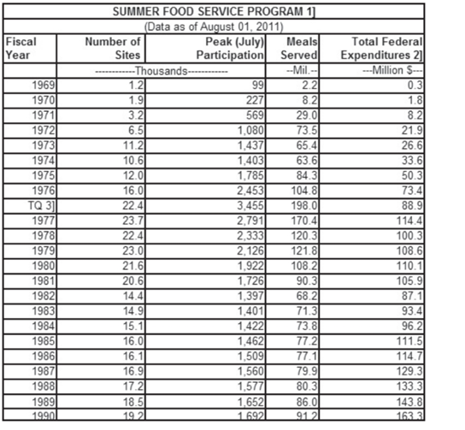
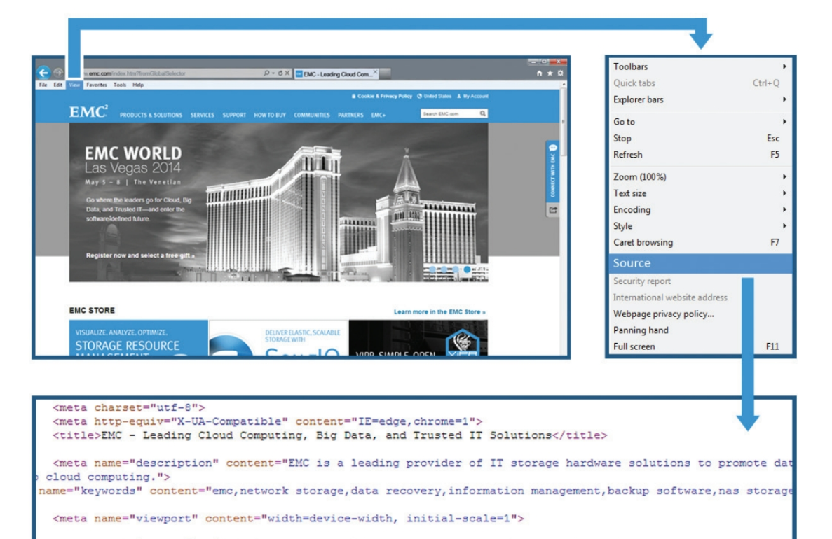
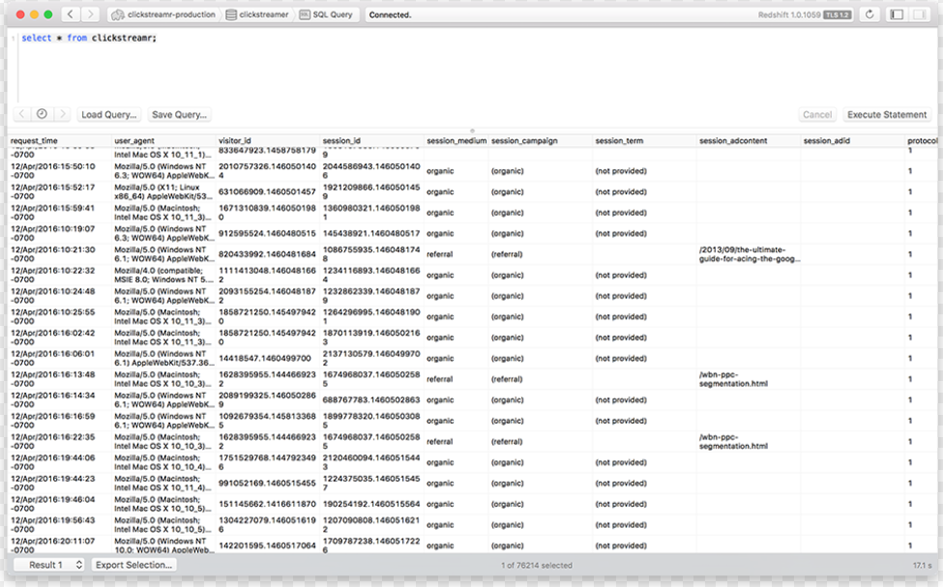
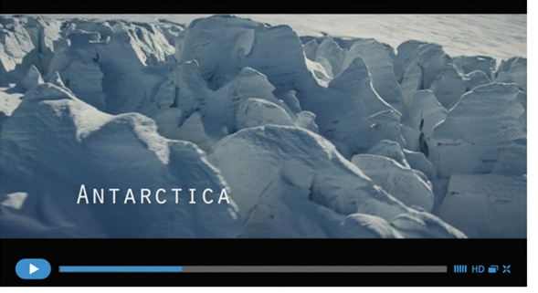
Sample 2
Data Examples
Structured Data
Semi-Structured Data
Quasi-Structured Data
Unstructured Data

Slide 12
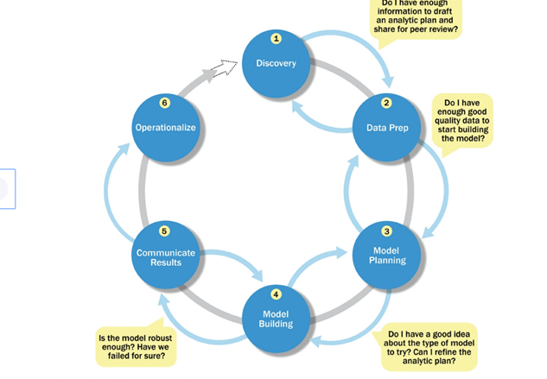
Check Out our PowerPoint Graphics Library
Data Analytics Lifecycle

Slide 13
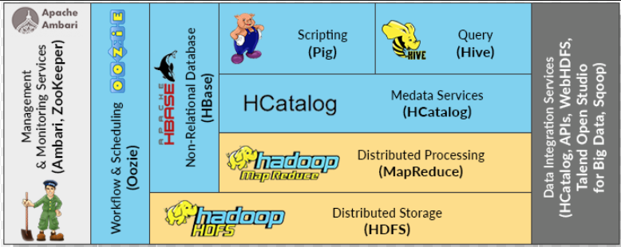
Sample 2
Big Data Technologies
Technologies (MapReduce, Hadoop, NoSQL)

Slide 14
Session 1 – Part 1 Data Science with R
Dr. Ying Ying Zhuang - Amazon

Slide 15

Break

Slide 16
Session 1 – Part 2 Centralize Logging and Data Pipeline
Yun Tse Wu - Mercedes Benz Research and Development North America (MBRDNA)

Slide 17
Sample 2
df
Group Discussion and Activity
What type of course can you develop
Title
Description
General concepts
Draft 3-4 course objectives

Slide 18

Sample 2
df
Lunch Break

